Slide 1


3D Graphics
Workshop 13 – Coursera week 15 and 16

Slide 2
Lab
Work on Workshop 13 Lab 1.
In this activity, we are going to
try out the standard light shader in Unity and
implement a simple Ambient, Diffuse and Specular Fragment Shader.

Slide 3
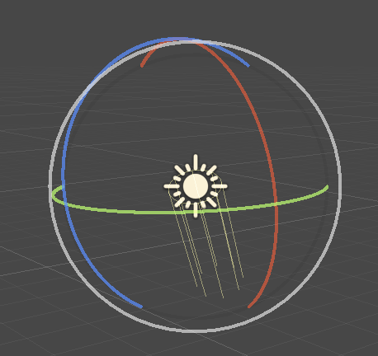
Lighting
Directional light
No position
Doesn’t matter how near or far the object is from Directional light
Has directional/angle
Model Sunlight
Sun position is too far, position doesn’t matter

Slide 4
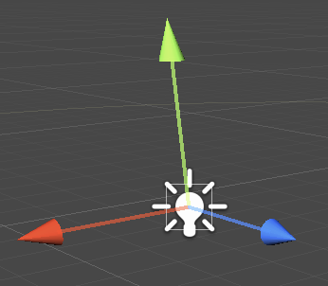
Lighting
Point light
Has position
Do matter how near or far the object is from point light
No directional/angle
Lights flow in every direction
Model lamp

Slide 5
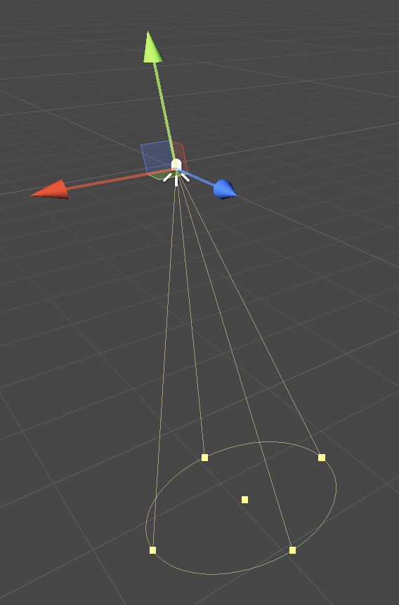
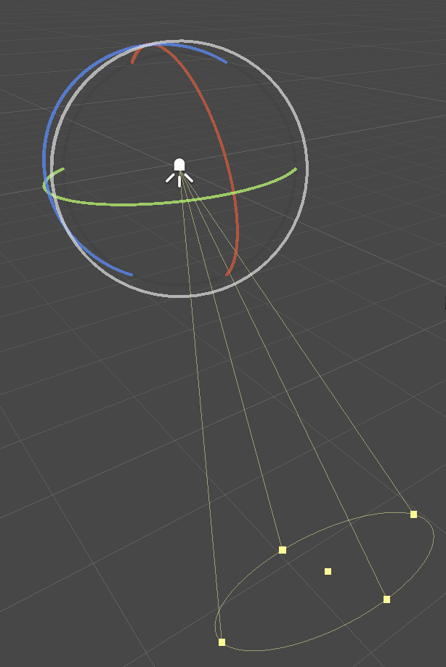
Lighting
Spotlight
Has position
Do matter how near or far the object is from point light
Has directional/angle
Lights flow in a certain corn
Model a spotlight in theater
narrow focus light that only shows shines on a certain spot.
the further the light is away, the wider the area covers because it's a cone.

Slide 6
Lighting
Ambient light
Comes from light bouncing off from surrounding object.
Very difficult to model.
Trick is to apply a constant low light value to all objects.
No position and direction.

Slide 7
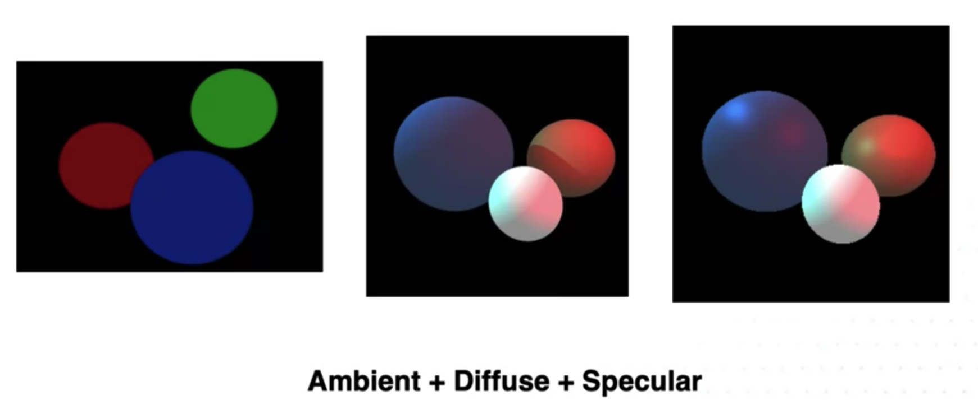
Light model
Three components
Ambient
Diffuse
Specular

Slide 8
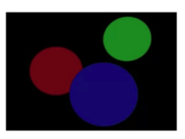
Light model
Ambient light
Set a constant value for the whole scene (I_{a})
Each object reflects only a proportion (k_{a})
k_{a} is parameter of the object this pixel is assigned to during the rasterization process
I_{r} = K_{a}I_{a}

Slide 9
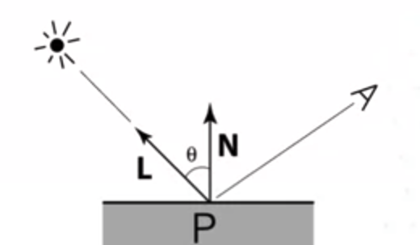
Light model
Diffuse
Lambert’s cosine law
the intensity of the light at a certain point is proportional to the cosine value of the angle between the surface normal and a light ray.
k_{d}I_{d} cos(𝜃) =
K_{d},the co-efficient of the surface material,
Higher K_{d}, higher percentage of light is reflected
I_{d}, the intensity of the light source,
cos(𝜃), the angle between the surface normal and the light ray. Also equals to (N.L)
k_{d}I_{d} cos(𝜃) = k_{d}I_{d} (N.L)
(N.L) = dot product of vector N and L.
N and L are unit vector (i.e. length of 1)

Slide 10
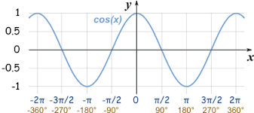
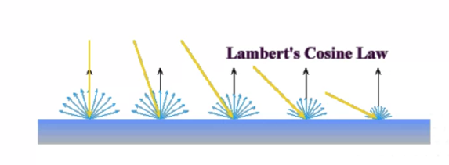
Light model
Diffuse
Lambert’s cosine law
the intensity of the light at a certain point is proportional to the cosine value of the angle between the surface normal and a light ray
N and L is in line
𝜃 is 0
Cos (0) is 1
very high
As 𝜃 increases
Cos (𝜃) goes lower

Slide 11
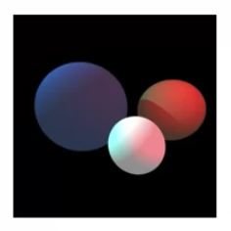
Light model
Ambient + Diffuse
I_{r} = K_{a}I_{a} + k_{d}I_{d} (N.L)

Slide 12
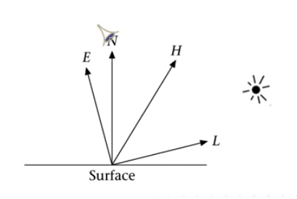
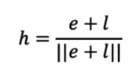
Light model
Specular
Need three vectors
Surface normal
Light direction
Viewing direction
Need to Compute vector H
H is a vector that bisects E
e and l are both unit vector

Slide 13
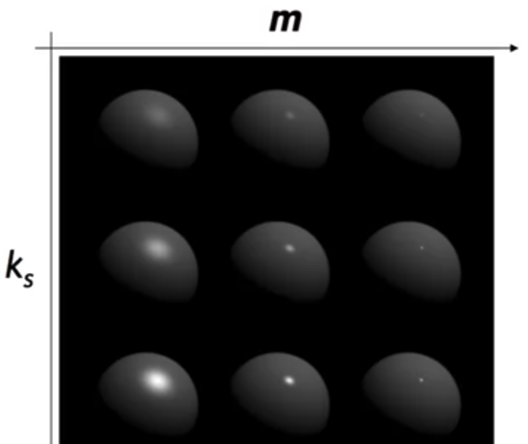
Light model
Specular
K_{s}I_{i} (h.n)^{m}
m
shininess (positive)
The higher the m, the more quickly the highlight effect vanishes
Control the size and intensity of the highlights
Ks – as ks increases, more light object reflects

Slide 14
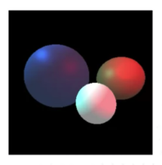
Light model
Ambient + Diffuse + Specular
I_{r} = K_{a}I_{a} + k_{d}I_{d} (N.L) + K_{s}I_{i}(h.n)^{m}
Assume I_{d} and I_{i} is the same light source.
Let I_{i} = I_{d}
I_{r} = K_{a}I_{a} + k_{d}I_{i} (N.L) + K_{s}I_{i}(h.n)^{m}
= K_{a}I_{a} + I_{i}(k_{d} (N.L) + K_{s}(h.n)^{m})

Slide 15
Lab
Work on Workshop 13 Lab 1.
In this activity, we are going to implement a few simple Vertex and Fragment Shader.

